Slide 1
CodeX and RGB
Setting pixels to any color using RGB tuples

Slide 2
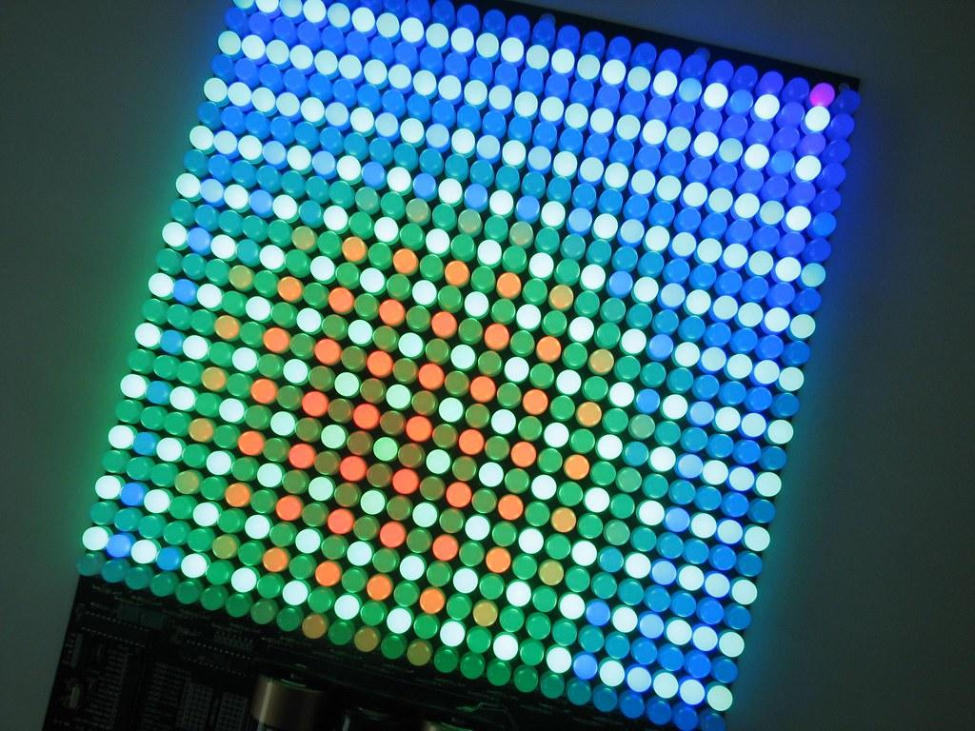
What is RGB?
RGB stands for Red, Green, Blue.
Find out more by watching the short video on the next slide.

Slide 3

Code.org video on pixels
Watch from
0:45 to 2:35

Slide 4

Getting RGB values
The video mentions “triplets” of numbers. Each number in the triplet represents a value in RGB.
= ( 47, 147, 181)
The first number is the amount of red
The second number is the amount of green
The third number is the amount of blue

Slide 5
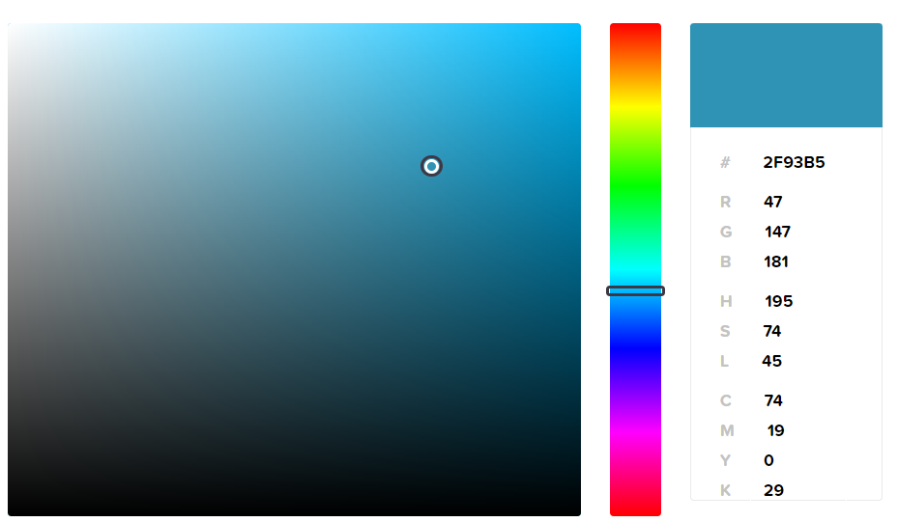
Getting RGB values
Use online software to select a color and find the RGB colors.
(47, 147, 181)
In Python, the triplet is called a “tuple”

Slide 6
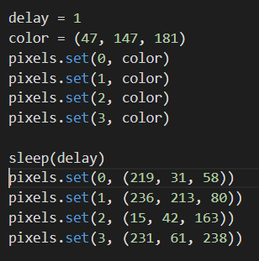
Using RGB values
Set your own colors by changing the color value to a tuple instead of a built-in color:
color = (47, 147, 181)
You can do this throughout the program, as often as you want. Or set the value in the pixels.set command.

Slide 7
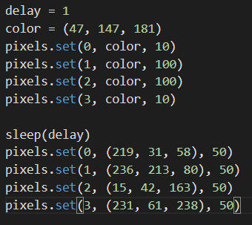
Using RGB values
You can add a third value in the pixels.set() command, which determines the brightness.
Brightness values are from 0 to 100

Slide 8
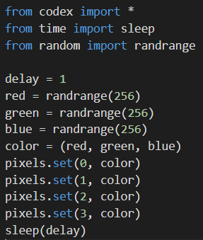
Random RGB values
If you want to try something new, generate random numbers for R, G and B and see what color happens!
Everytime you run the code, or add the code multiple times, you should get a different color.

